Slide 1

Company Profile
Office/Fax: (632) 576-6343
Address: #10 Jenny’s Avenue, Barangay Rosario, Pasig City

Slide 2









WCL Group of Companies
The World Class Laminate (WCL) Group of Companies has been serving the Construction Industry since 1995. Known for being an industry leader in the furniture space, the WCL Group aims to continue offering excellent products to the thriving Philippine market.
Laminated Boards and Furniture
Sheet Metal, Electrical, Data
Construction
Corporate Social Responsibility

Slide 3
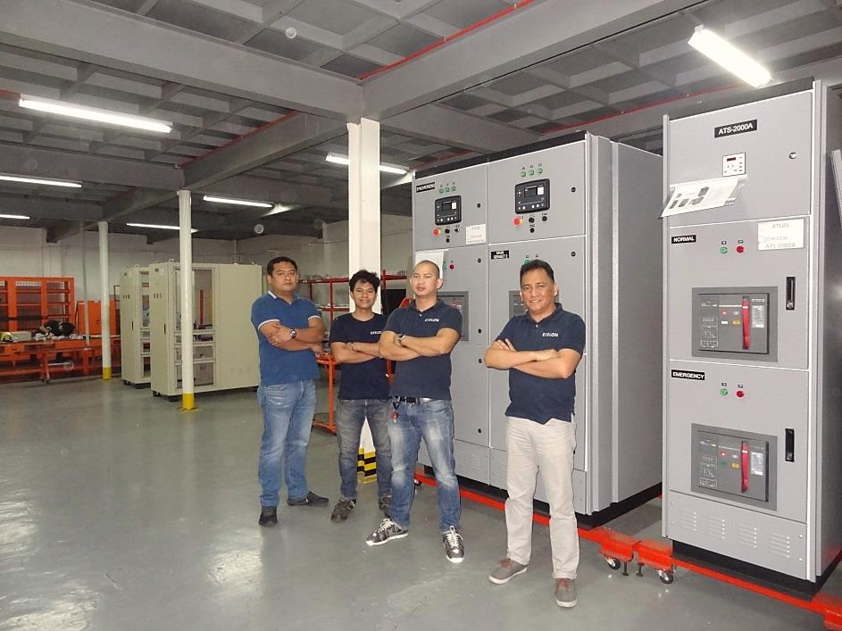
About Us
About Us
EXELON POWER SOLUTIONS, INC. specializes in switchgear manufacturing and electrical panel building. We provide services for:
Power Generation and Distribution
Industrial & Commercial Applications
Preventive Maintenance Services
EXELON understands that the need for a safe and reliable power supply solutions are paramount.
So we emphasize providing exceptional quality and uncompromised safety at a competitive price point. Finally, we pride ourselves on excellent customer orientation, so your required specifications, budget and project deadlines are our main concern.

Slide 4
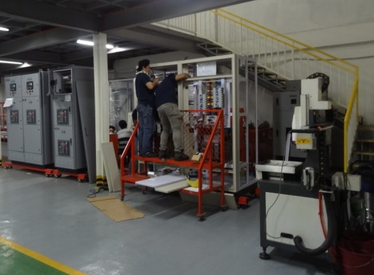
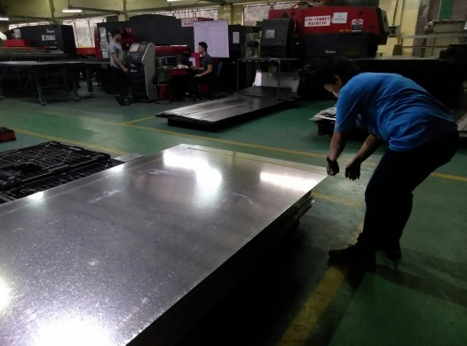
Why Exelon?
Exelon is able to meet high product quality and customer satisfaction with our Production Management methodologies
Workmanship
Technical expertise on sheet metal fabrication and copper busbarring technologies
Quality Standard
Testing Methodology
Continuous Improvement
Employee training opportunities promote skillset and talent development
Rigorous Quality Assurance process is performed with our 10-point inspection
Ensuring safety through investment in high precision testing equipment
Full client transparency on raw materials used, and manufacturing process
Scalable processes are attained by performing regular operational analysis
LVSG Assembly
Raw material inspection

Slide 5
Production Process & Capabilities
Production Metrics | #
Years in Operation | 2 years
Total Manpower | 150
Plant #1 (Pasig) Production Area | ~4,000 sqm
Plant #2 (Laguna) Production Area | ~1,000 sqm (with more room for expansion)
Legend:
Sheet Metal Fabrication
Switchgear/Panel Mfg

Slide 6
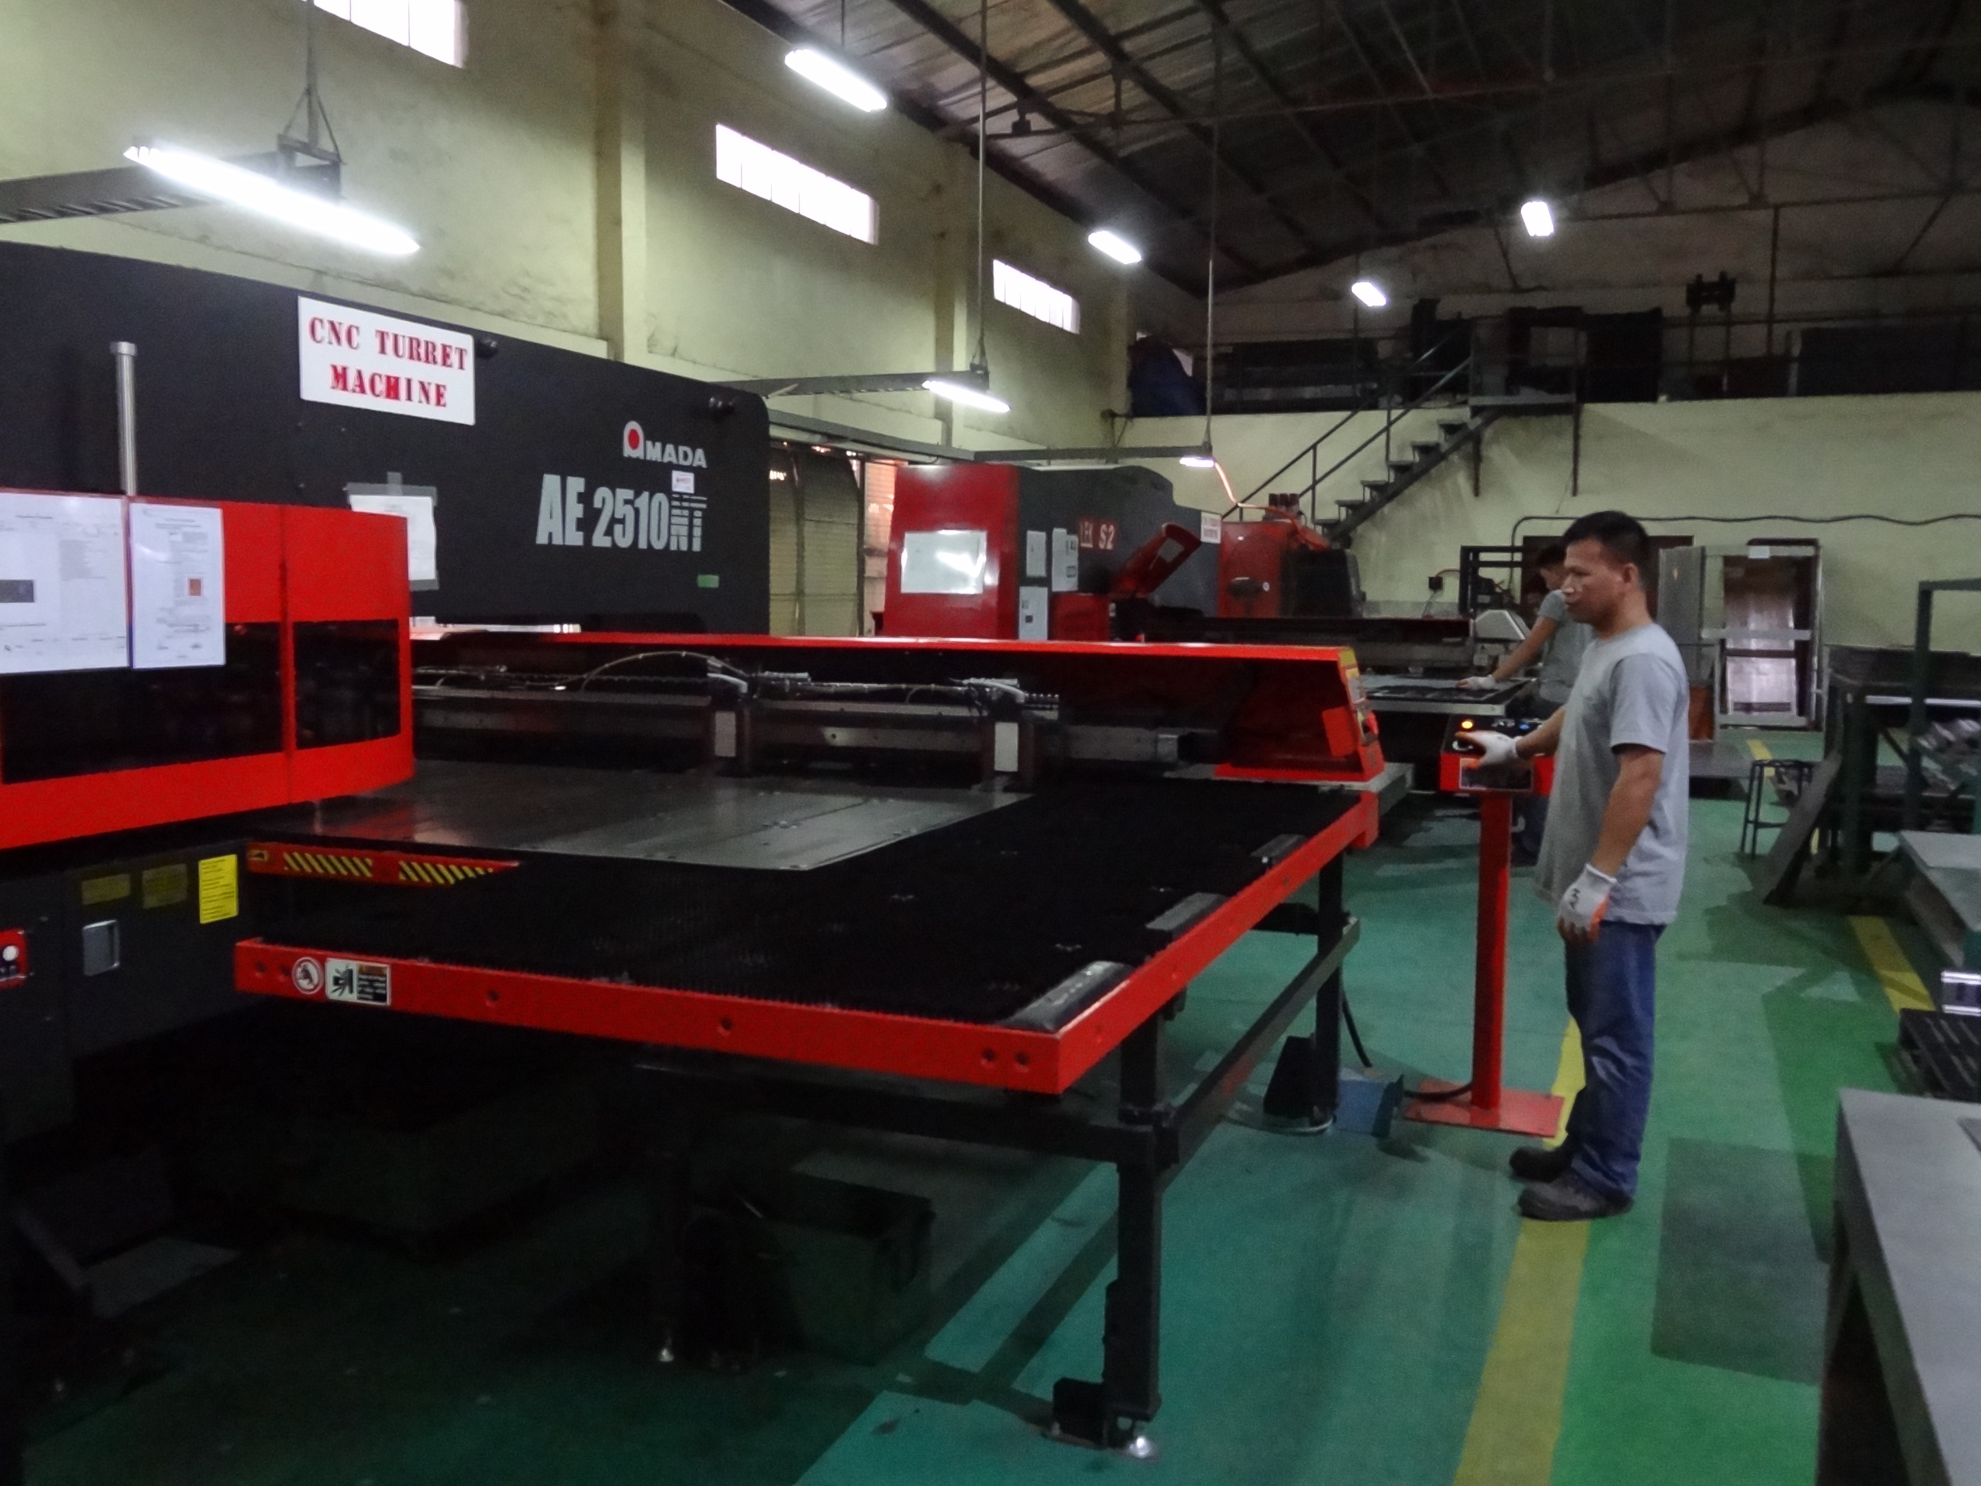
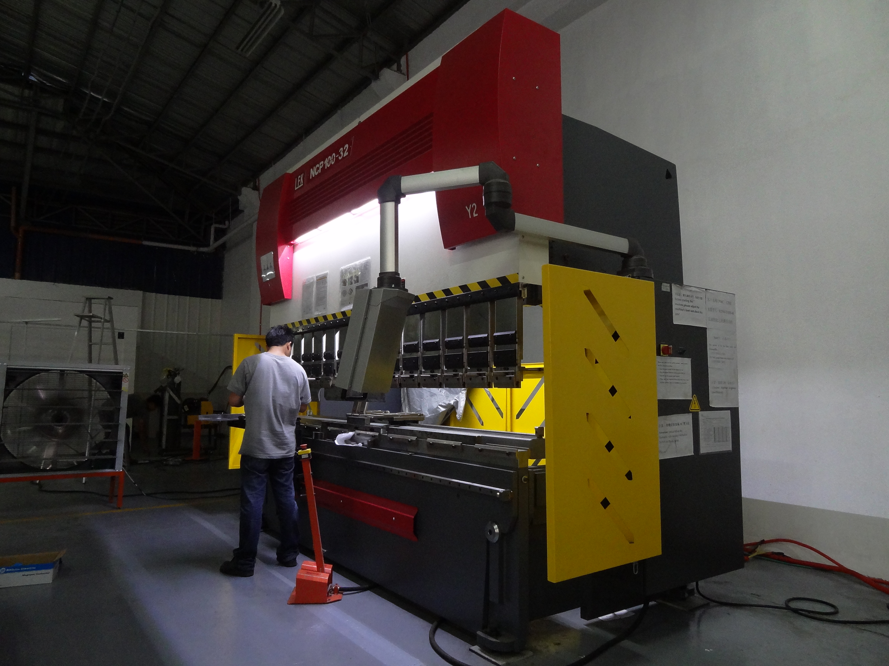

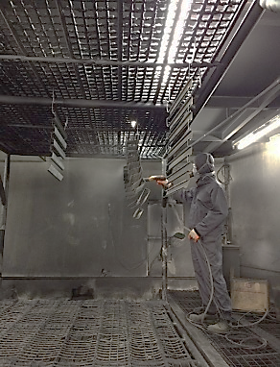
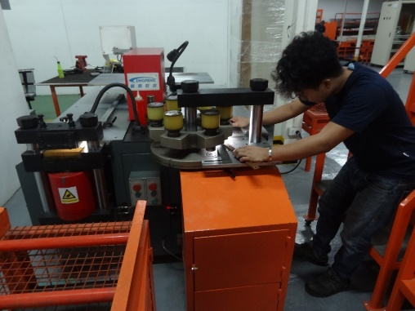
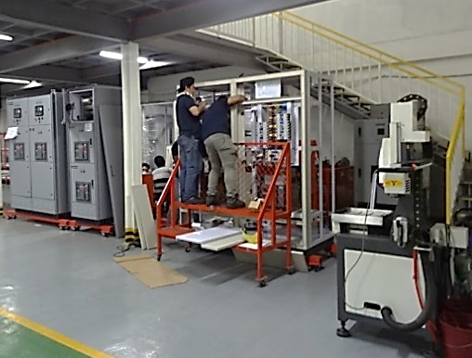
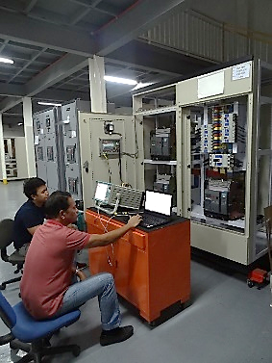
Production Process & Capabilities
1
Turret Punching
2
Press Break/Bending
3
Welding
4
Powder Coating
5
Copper Busbarring
6
Switchgear Assembly
7
Testing

Slide 7
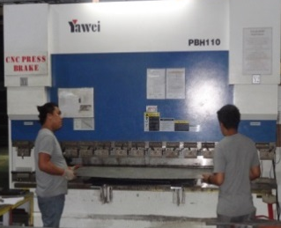
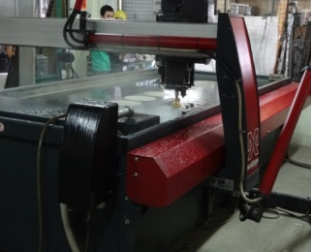
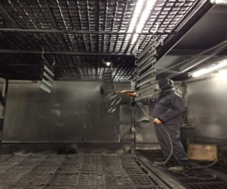
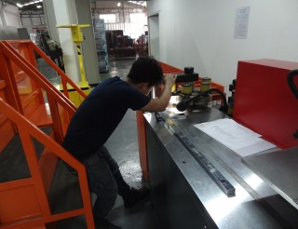
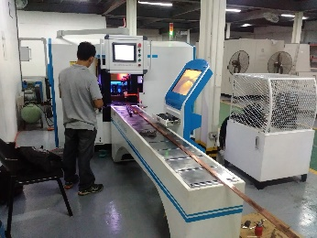
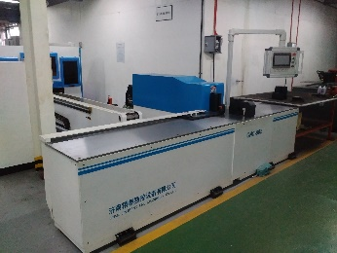
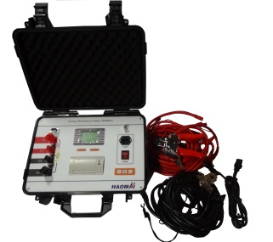
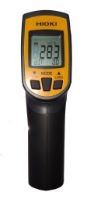
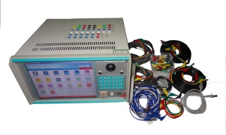
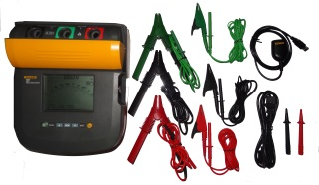
Advance Manufacturing Equipment
Exelon invests in high-end machinery to consistently maintain production accuracy and accommodate for a wide range of market demands
Metal
Processing
CNC Turret Punching
CNC Press Break
CNC Water Jet Cutting
Powder Coating Facility
Busbar
Processing
3-in-1 Busbar Worker
CNC Busbar Punching & Shearing
CNC Busbar Bending
Test
Equipment
Relay Tester
Thermal Scanner
Insulation Tester Fluke 1555
Contact Resistance Tester

Slide 8
Advance Manufacturing Equipment
Below is a comprehensive list of our machinery and equipment
Machine | Quantity
CNC Water Jet | 1
CNC Turret Punching (20 tons) | 3
CNC Press Brake (125 tons x 3 meters) | 4
CNC Busbar Punching & Shearing | 1
CNC Busbar Bending | 1
NC Shearing | 2
Welding machine | 9
PEM – Clinching | 1
Batch Type Powder Coating Line | 1
PLC Control Bus Bar Cutting, Punching & Bending Machine | 1
Label Printer | 1
CNC Engraving Machine | 1
Testing Equipment | Quantity
Relay Tester | 1
Contact Resistance Tester | 1
Multimeter Tester | 1
10kv Insulation Tester Fluke 1555 | 1
Clamp Meter Tester | 1
Temperature Scanner | 1

Slide 9
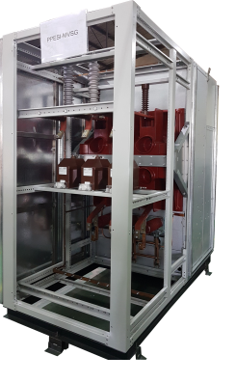
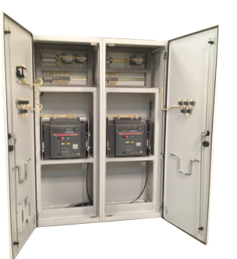
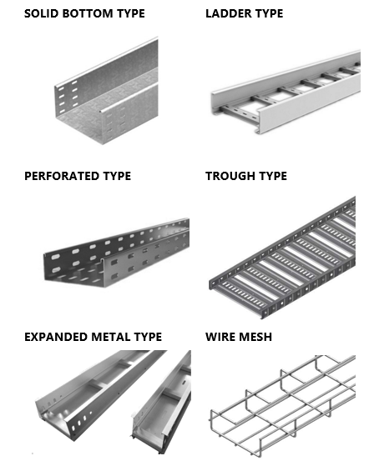
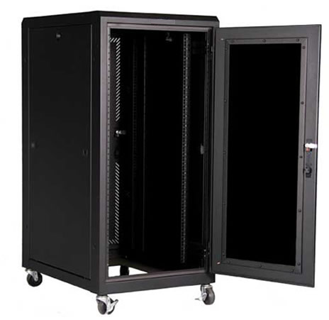
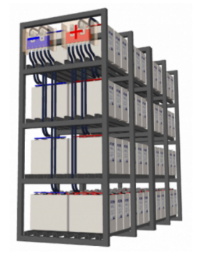
Manufactured Product Portfolio
Electrical Equipment
Cable Trays and Ladders
IT Data Cabinets
Data Center Products
Medium Voltage Switchgear
Low Voltage Switchgear
Motor Control Center
Capacitor Bank
Transfer Switches
Enclosed Circuit Breaker
Panel Boards
Synchronizing Panels
Junction Boxes/Pull Boxes
Transformer
Genset
Solid Bottom Type
Ladder Type
Perforated Type
Trough Type
Expanded Metal Type
Wire Mesh
Wall Mounted
Floor Mounted
Server and Network Cabinets
Accessories and Hardware Kits
Structured Cabling
Integrated Cabinets
Battery Racks and Cabinets

Slide 10
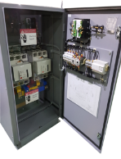
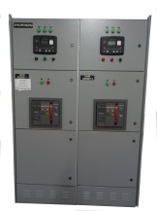
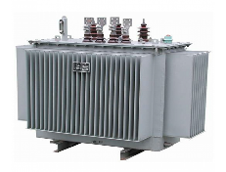
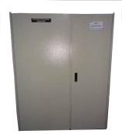
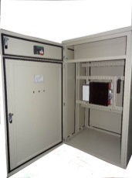
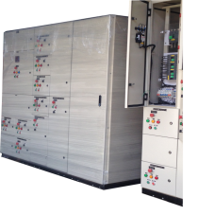
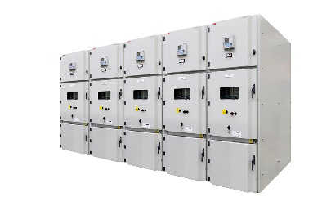
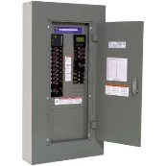
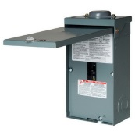
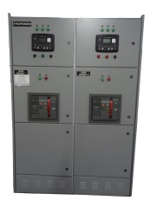
Substation Equipment
Exelon has deep experience and capabilities in designing and manufacturing an extensive suite of substation equipment
Transformer
ATS
Capacitor Bank
Synchronizing
Panel
DB
MCC
MVSG
Panel Board
ECB
LVSG

Slide 11











End-to-end Solutions
Exelon provides end-to-end turnkey solutions, which utilize equipment from reputable and innovative brands. We have determined that our range of brands fit the technical and commercial requirements of the Philippine market.
Low & Medium Voltage
Genset
Transformer
Busduct
Primary Partners
Other Brands

Slide 12

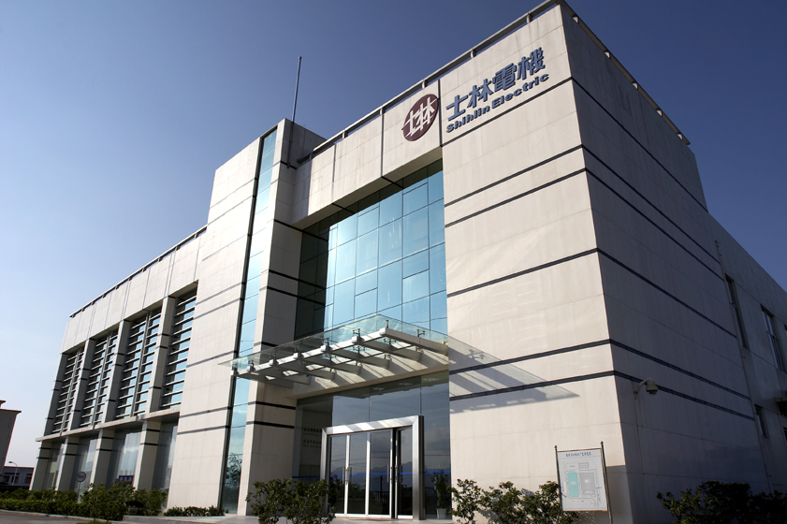
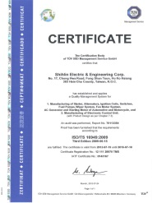

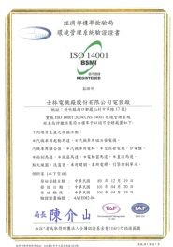
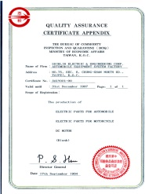
Corporation Brief
Shihlin Motors specializes in R&D and manufacturing of power-related products. With more than 60 years of deep foundations and superior technology, Shihlin Electric Co., Ltd., through its strategic alliance with major international companies, has completed its core competitiveness and has strong competitiveness in the international market.
Product Line
Low Pressure Switch
Heavy-duty Products
Industrial Control Products
Automation Engineering Integration
Certificates
Bureau of Inspection and Quarantine - ISO14001
Ford Q1 Preferred Quality Award
Taiwan Quality Association - Quality Control Group Award

Slide 13



Certificate of Partnership

Slide 14
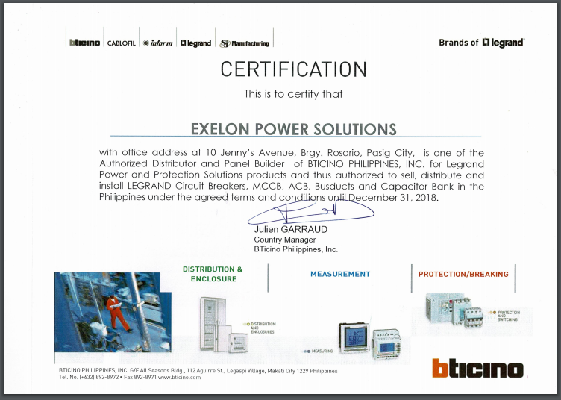
Certificate of Partnership

Slide 15
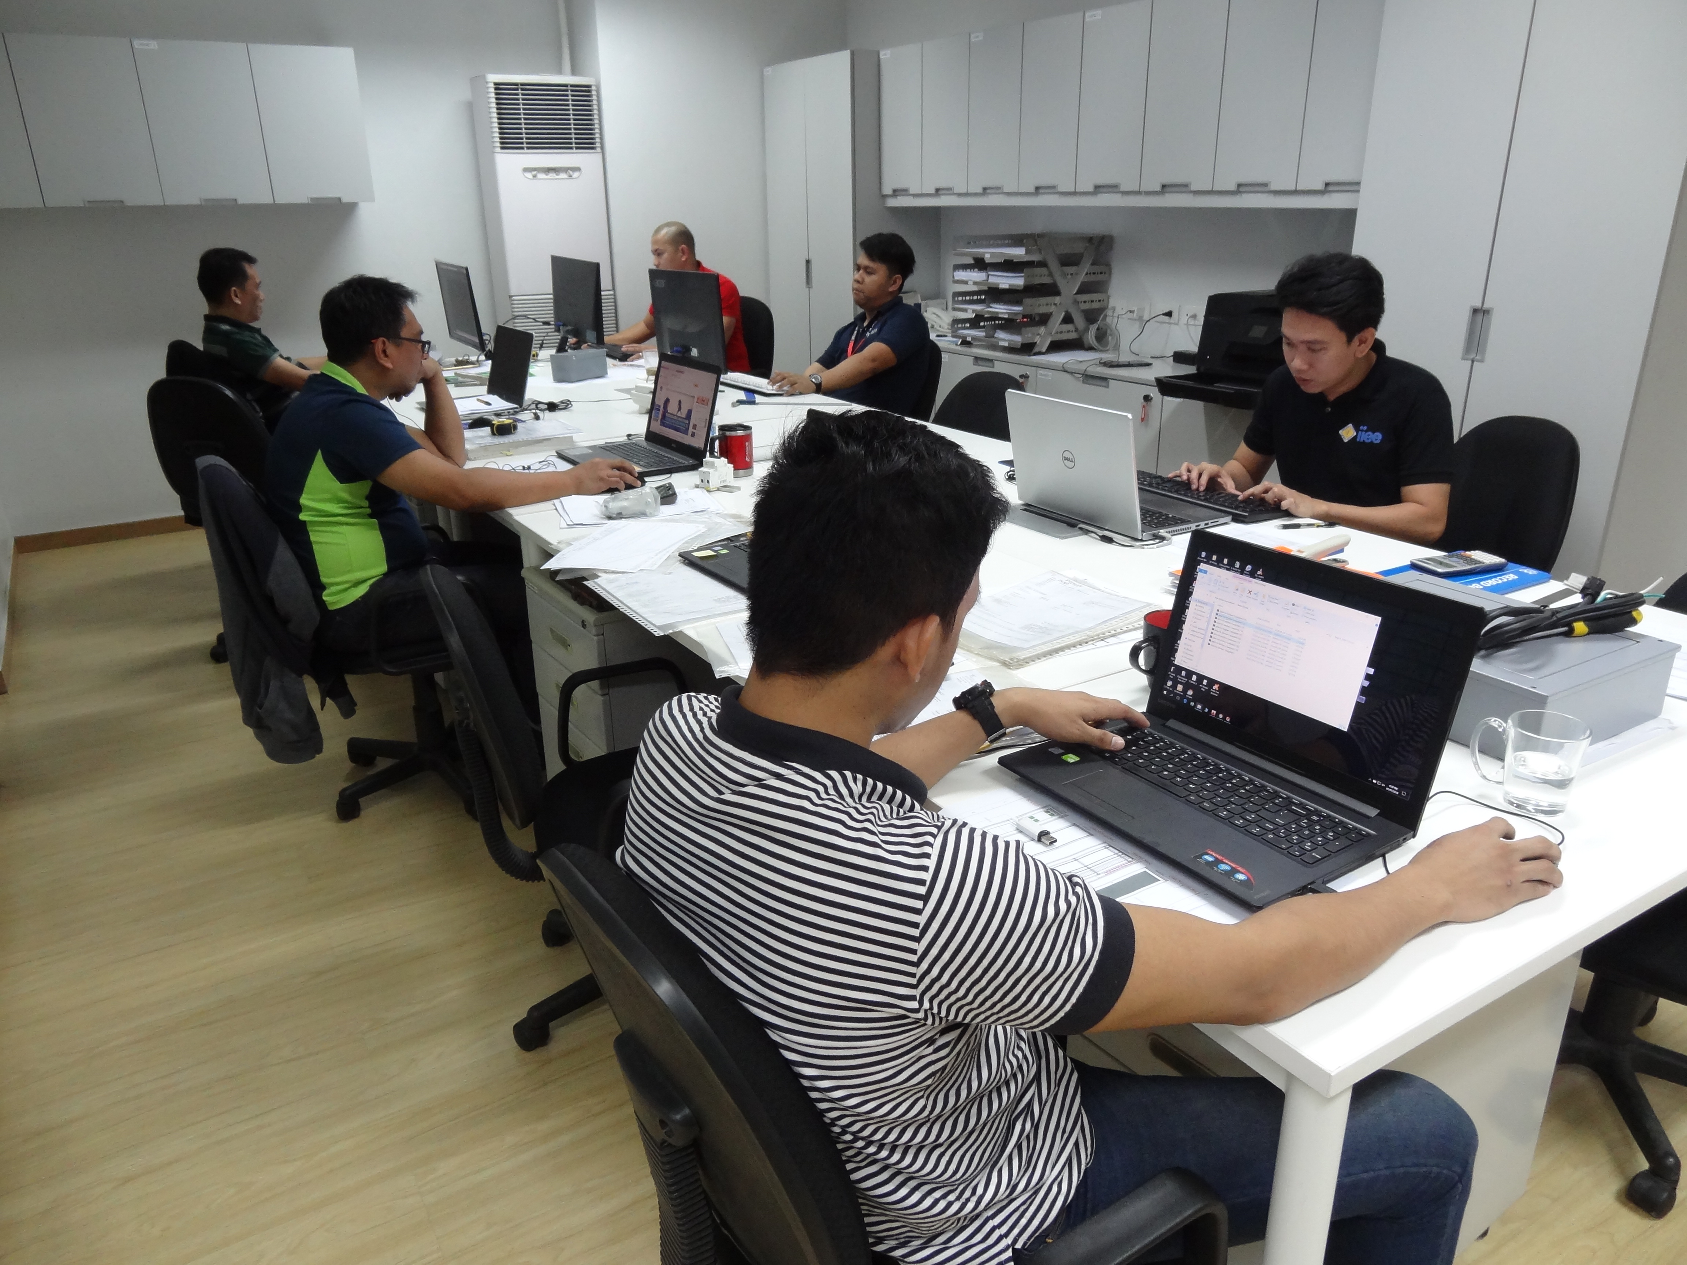

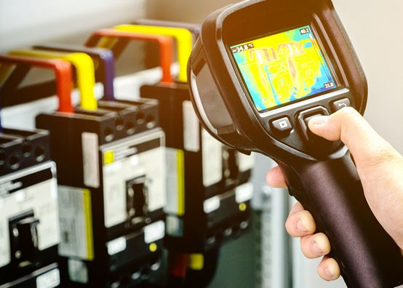
Our Team
R&D
Manufacturing
Service
Designs turnkey solutions
Complies with customer requirements
Recommends cost-effective solutions
Invests in new product development and testing
Practices lean manufacturing methodologies to achieve quality and cost-efficiency
Emphasizes on fine workmanship
Ensures timeliness of deliveries and/or installations
Provides quick response to any commissioning or operational issues which might occur
Receives regular training from our partners on the entire product line offering

Slide 16
Recent Projects

Slide 17

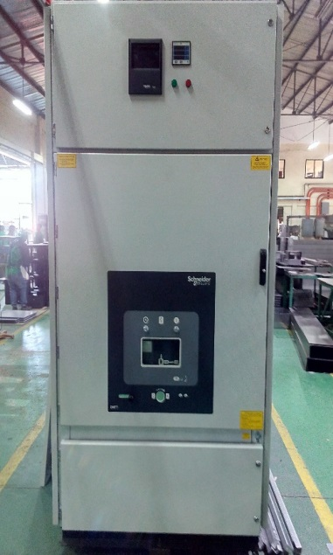
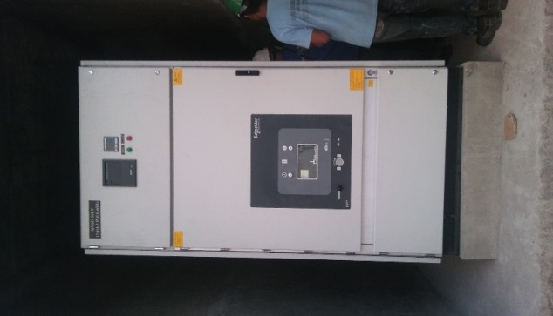
URC
INDUSTRY: INDUSTRIAL
SCOPE: Supply of 36kV MVSG
LOCATION: Pasig City

Slide 18

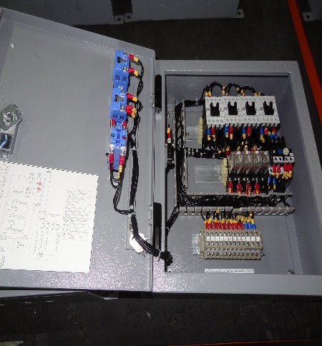
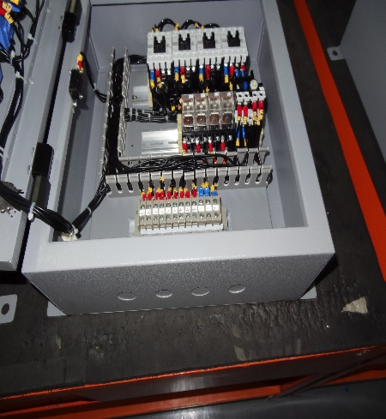
Okada Casino
INDUSTRY: CASINO
SCOPE: Supply of 1,900 BMS Panels
LOCATION: Pasay City

Slide 19

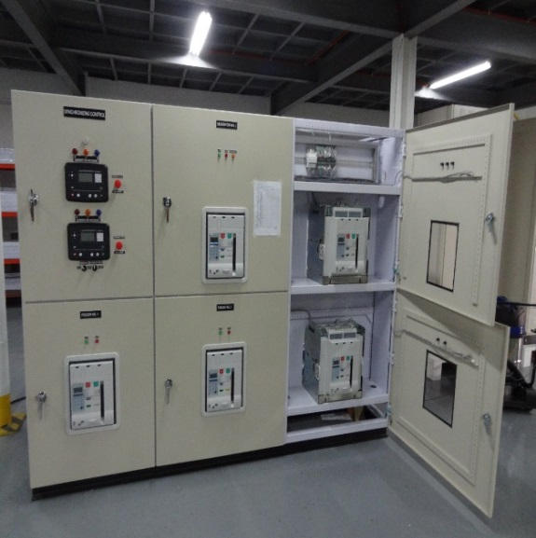
Evia Mall
INDUSTRY: RETAIL
SCOPE: Supply of LVSG Synchronizing Panels
LOCATION: Alabang

Slide 20

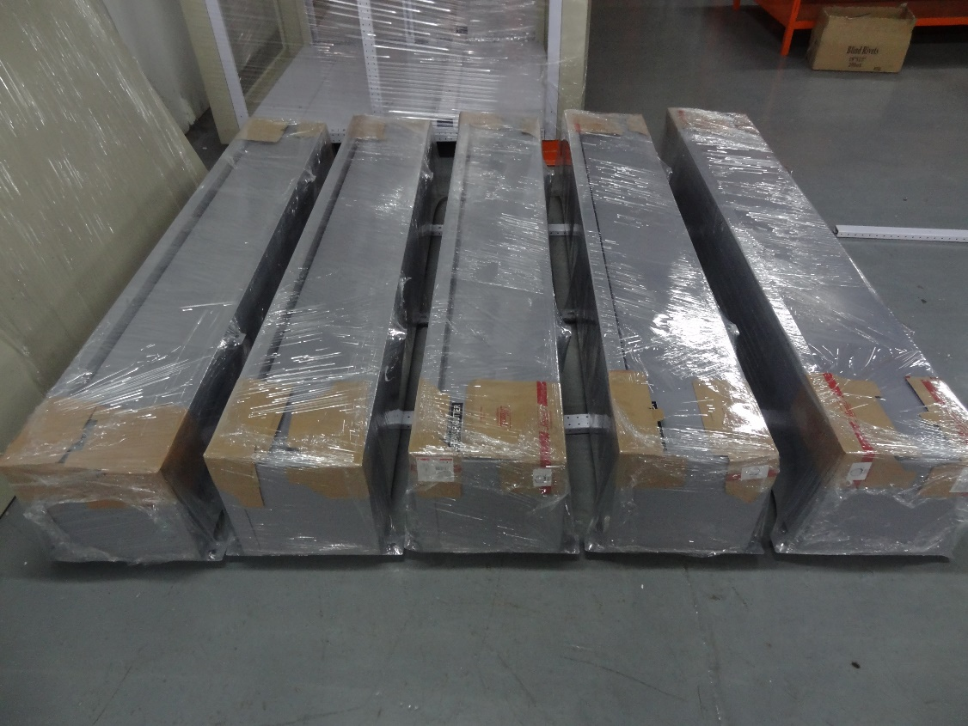
EEI Corporation
INDUSTRY TYPE: RESIDENTIAL
SCOPE: Supply of various Panel Boards and Breaker Gutters
LOCATION: Quezon City

Slide 21

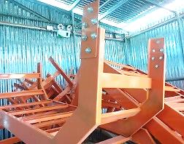
Nestle Philippines
INDUSTRY TYPE: Dairy Products Plant
SCOPE: Supply and Delivery of Cable Trays (Ladder Type)
TOTAL CAPACITY: 670 Lengths
CONTRACTOR: EEI Corporation
OTHER DETAILS:
  First Philippine Industrial Park, 4232 Tanauan City, Batangas
  Nestlé Philippines Inc (NPI)
  On-going May – June 2018

Slide 22

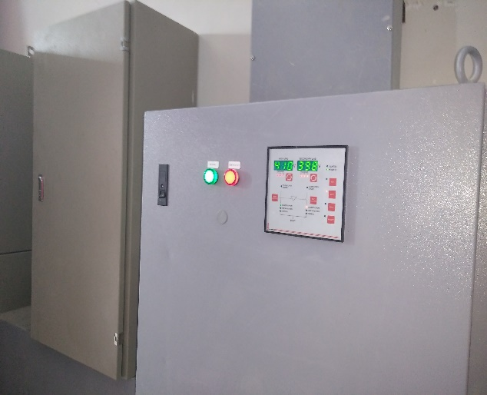
Aseana City
INDUSTRY: CONSTRUCTION
SCOPE: Supply of LVSG ATS Panel
LOCATION: Pasay City

Slide 23

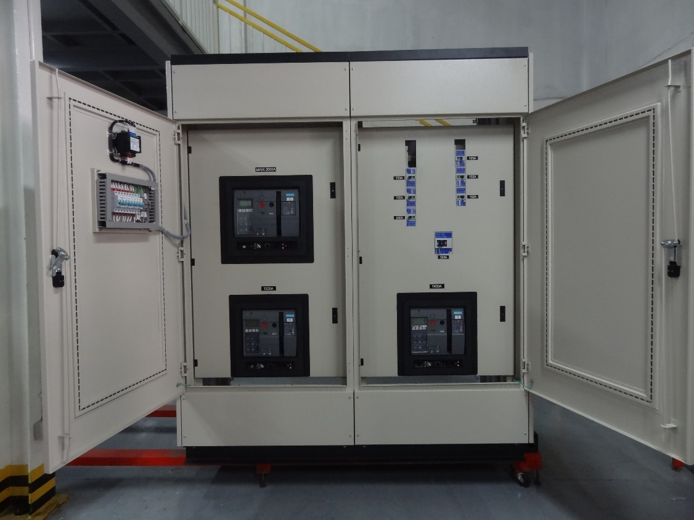
Jobstarr Technoserve
INDUSTRY TYPE: ELECTRICAL
SCOPE: Supply of LVSG
LOCATION: Mariveles, Bataan

Slide 24


Marinduque
Hospital
INDUSTRY: HEALTHCARE
SCOPE: Supply of LVSG, Synchronizing and ATS Panels
LOCATION: Marinduque

Slide 25



University of
Sto. Tomas
INDUSTRY: SCHOOL
SCOPE: Supply of LVSG ATS Panels
LOCATION: Sampaloc, Manila

Slide 26



Atlas Circuit , Inc.
INDUSTRY TYPE: ELECTRICAL
SCOPE: Supply of ATS Panels

Slide 27



CJC Electric
INDUSTRY TYPE: ELECTRICAL
SCOPE: Supply of MTS Panels

Slide 28



RDT Industrial Sales & Services Inc.
INDUSTRY TYPE: ELECTRICAL
SCOPE: Supply of Capacitor Bank
LOCATION: Mandaue, Cebu

Slide 29


RDT Industrial Sales & Services Inc.
INDUSTRY TYPE: ELECTRICAL
SCOPE: Supply of LVSG Unitized Panels
LOCATION: Mandaue, Cebu

Slide 30


Enercon
INDUSTRY TYPE: ELECTRICAL
SCOPE: Supply of ATS Panel
LOCATION: Cabanatuan, Cebu

Slide 31


MH Poly-
Electromechs, Inc.
INDUSTRY TYPE: ELECTRICAL
SCOPE: Supply of By-Pass Panel

Slide 32


Piedra Electric Supply
INDUSTRY TYPE: ELECTRICAL
SCOPE: Supply of Main Distribution Panel

Slide 33

DLSU - Canlubang
INDUSTRY: SCHOOL
SCOPE: Supply of various panels such as, Low Voltage Switchgear, Panelboards, Main Distribution Panel & Busbar Gutters.
LOCATION: Canlubang, Laguna

Slide 34


Cagayan Valley
Medical Center
INDUSTRY TYPE: HEALTHCARE
SCOPE: Supply of various panels such as Panelboards, Main Distribution Panel & Busbar
Gutters.
CLIENT : R.R. Encabo Contructors, Inc
LOCATION: Tuguegarao City

Slide 35
Appendices

Slide 36
Appendix A: Organizational Chart
Lawrence Tiu
Managing Director
Ed Cabral
General Manager
Accounting (4)
Mhae Vergara
Supply Chain (7)
Shiela
Dela Cruz
HR, IT & Admin
(3)
Vanessa Forteo
Biz Dev & Sales (8)
Ernalyn Ilas
Engineering (12)
Erwin Dumlao
Production & QA/QC (113)
Arnel Canlas
After-Sales & Testing
(3)
Eugene Quitola

Slide 37
Appendix B: Clients and Projects
YEK YEU MERCHANDISING, INC
RDT INDUSTRIAL SALES & SERVICES, INC
R.R. ENCABO CONTRUCTORS, INC
EEI CORPORATION
EEI POWER CORPORATION
GLOVAL INTEGRATED SOLUTIONS AND TECHNOLOGICAL SERVICES, INC
PRIME POWER ENERGIE SYSTEM, INC
ATLAS CIRCUITS, INC
ENERCON SYSTEMS INTERNATIONAL PHILIPPINES CORP
MH-POLY ELECTROMECHS, INC
ELOHIM INDUSTRIAL SALES, INC
MECHANICAL HANDLING EQUIPMENT COMPANY INC
8GIG KONSTRUCT, INC
INFINITE INTEGRATED SYSTEMS, INC
INFINITE POWER SYSTEMS, INC
RLC ELECTRICAL SERVICES, INC
WHOLESALE ELECTRIC ASIA (PHILIPPINES), INC
ROGANDO CONSTRUCTION CORP
EQUIPMENT AUTOMATION SOLUTION TECHNIQUE (EAST), INC
ECO PLAZA BUILDING
CAPTURED ENERGIE GREEN SOLUTION, INC
GTECH SOLUTIONS, IN
ACT CENTERLINE ELECTRICAL & MECHANICAL CORPORATION
ARCH JOVS DE GUZMAN
IRAH JAMES DELA CRUZ
FIRST PHILEC, INC
A.G. ARAJA CONSTRUCTION AND DEVELOPMENT CORP.
DATASHIELD OEM SOLUTIONS, INC
METALLFIT, INC
STAHL BUILDING SYSTEMS, INC
PASIG GREEN PASTURE CHRISTIAN SCHOOL
OPERATION AND MAINTENANCE TECHNOLOGY PHILIPPINES, INC
R. DAN AND COMPANY INC
ACASYSKBAR DEVELOPMENT CORPORATION
ROCKWELL PRIMARIES DEVELOPMENT CORPORATION
MAKATI DEVELOPMENT CORPORATION
FLUX WEBER ELECTRIC CORPORATION
HILLMARCS CORPORATION
ROBINSONS LAND
ORTIGAS & COMPANY
WILCON DEPOT
WALTERMART
MONOCRETE
ADGO ARCHITECTURE AND DESIGN INC.

Slide 38


Appendix C: Business Permits

